Slide 1

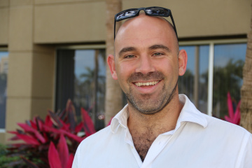
The seminar by Edoardo Persichetti will take place
27 February 2026 at 2:30 pm
Politecnico di Torino, Aula Buzano – DISMA third floor
Professor Edoardo Persichetti (Department of Mathematics and Statistics - FAU Florida Atlantic University) in person at the Department of Mathematical Sciences of the Politecnico di Torino.
On Practical Post-Quantum Signatures from the Code Equivalence Problem
Abstract: The design of secure post-quantum digital signatures is a particularly important and current topic, especially considering the presence of initiatives such as NIST’s call for proposals. While lattice-based designs offer intriguing solutions (some of which were recently standardised) NIST itself expressed the desire for alternatives, based on different security assumptions. Code-based signatures are historically challenging to design, due to the intrinsic nature of the Hamming metric, and the syndrome decoding problem; however, a recent approach exploiting the notion of code equivalence offers an interesting alternative. In this talk, we briefly summarise the state of the art, introduce the LESS signature scheme, and then present recent developments which greatly contribute to making it one of the most promising code-based signature schemes in literature.

