Slide 1

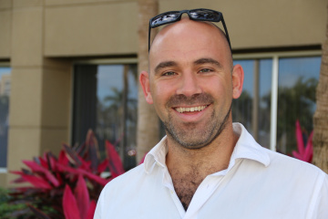
The starting lesson of PhD Course by Edoardo Persichetti will take place
16 February 2026 at 1000 am
Politecnico di Torino, Aula Consulenze – DISMA third floor
The PhD course Code-based Cryptography will be taught by Professor Edoardo Persichetti (Department of Mathematics and Statistics - FAU Florida Atlantic University) in person at the Department of Mathematical Sciences of the Politecnico di Torino.
Course presentation: In this course, we explore code-based cryptography, starting from its unofficial birth with the McEliece cryptosystem, and arriving to modern-day schemes now under consideration at NIST to become new Post-Quantum standards. The course will include all relevant coding theory background.
Course syllabus:
Introduction to coding theory (linear codes, generator and parity-check matrices, error correction).
McEliece cryptosystem and its security foundations.
Variants and improvements of the McEliece scheme.
Code-based digital signatures and related primitives.
NIST Post-Quantum Cryptography standardization process and code-based candidates.
Advanced topics and current research directions.
Course schedule:
Monday, February 16, 10:00–12:00 and 14:30–15:30 (Aula consulenze)
Wednesday, February 18, 10:00–12:00 and 14:30–15:30 (Aula consulenze)
Friday, February 20, 10:00–12:00 and 14:30–15:30 (Aula consulenze)
Monday, February 23, 10:00–12:00 and 14:30–15:30 (Aula consulenze)
Wednesday, February 25, 10:00–12:00 and 14:30–15:30 (Aula consulenze)
Friday, February 27, 14:30–15:30, final seminar (Aula Buzano)

